Slide 1
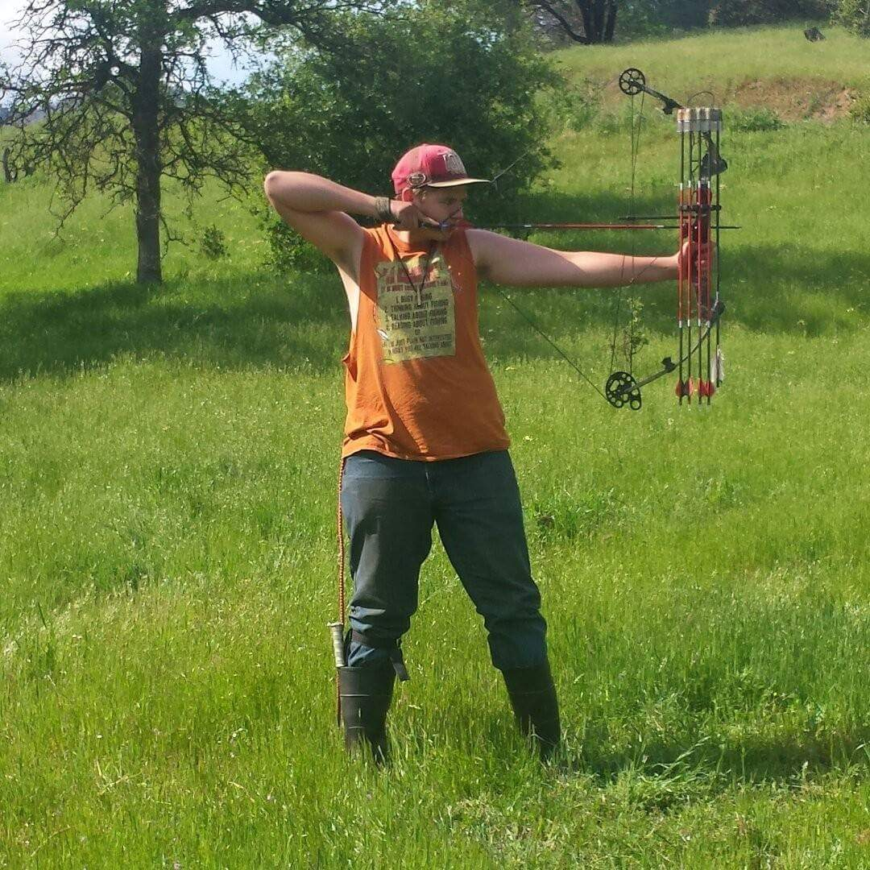
Jacob Blair

Slide 2
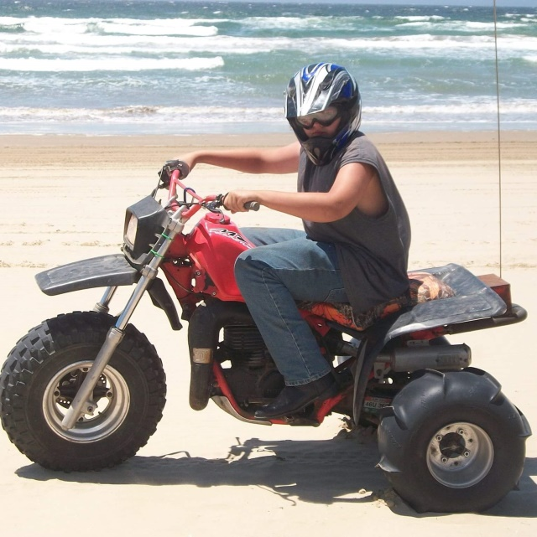
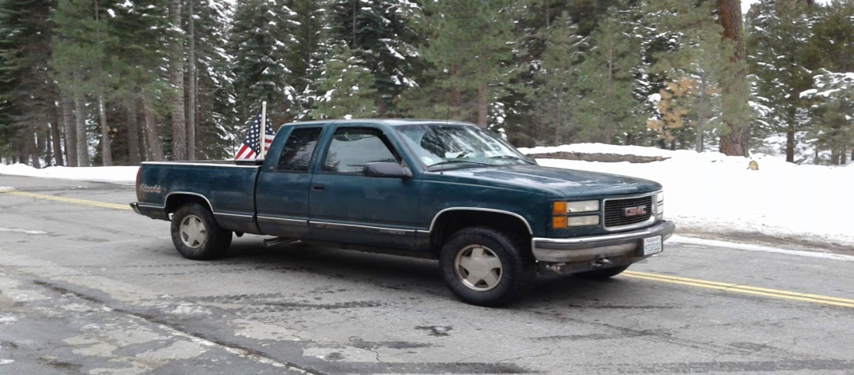
About Me
I'm an outdoors type of person
I like to be with a small group of people
My favorite things to do is hunting and fishing

Slide 3
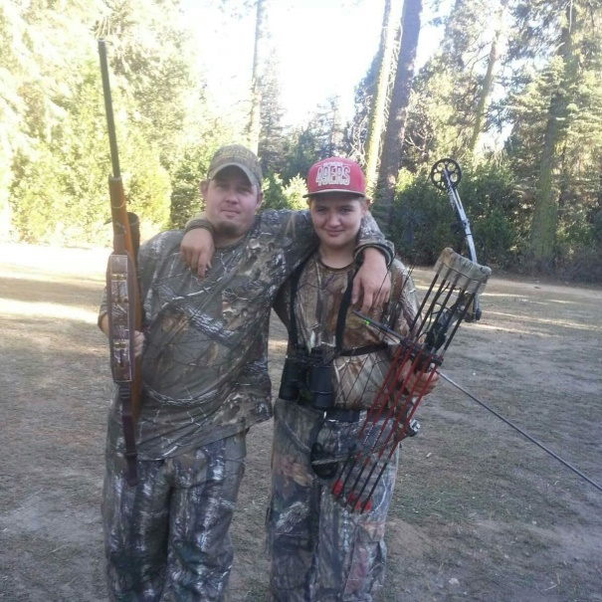
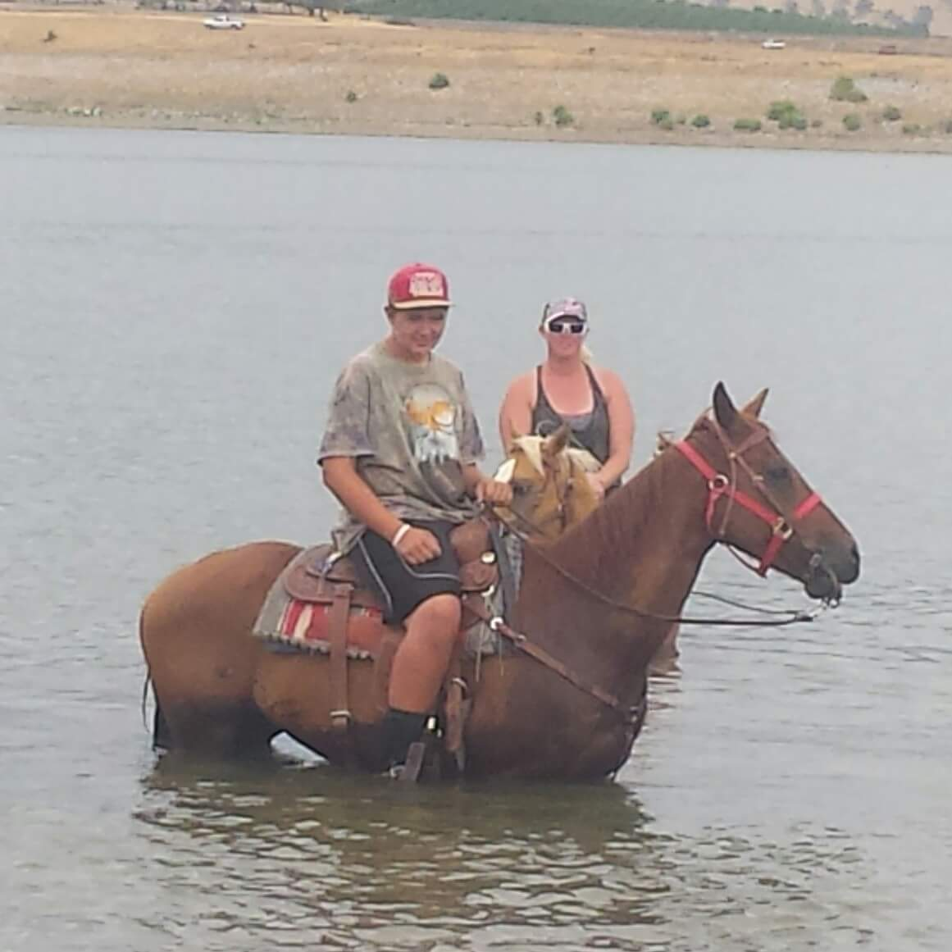
Through out High School
I have become who I am
I have made new friends
Found out what I want to do after high school

Slide 4
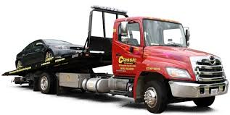
Job Shadow (tow truck driver)
At first I liked the idea of a tow truck driver
But after I got into welding I decided I would rather do that
If welding didn’t work out I would probably go to towing

Slide 5
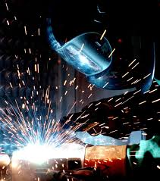
Pathway
My pathway is welding
It was guitar
I want to be a welder
I have learned all the basics

Slide 6
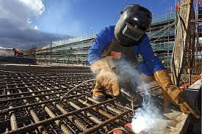
Post High School Plans
I plan on going to work
I want to go into the welding field
I'm going to get certified to weld
If I get into welding I will stay with it tell I retire if I can

Slide 7
Leaving LHS
learned from PBS to be responsible and that if you don’t do something its not leaving
LHS has taught me that people will help you all you have to do is ask

Slide 8
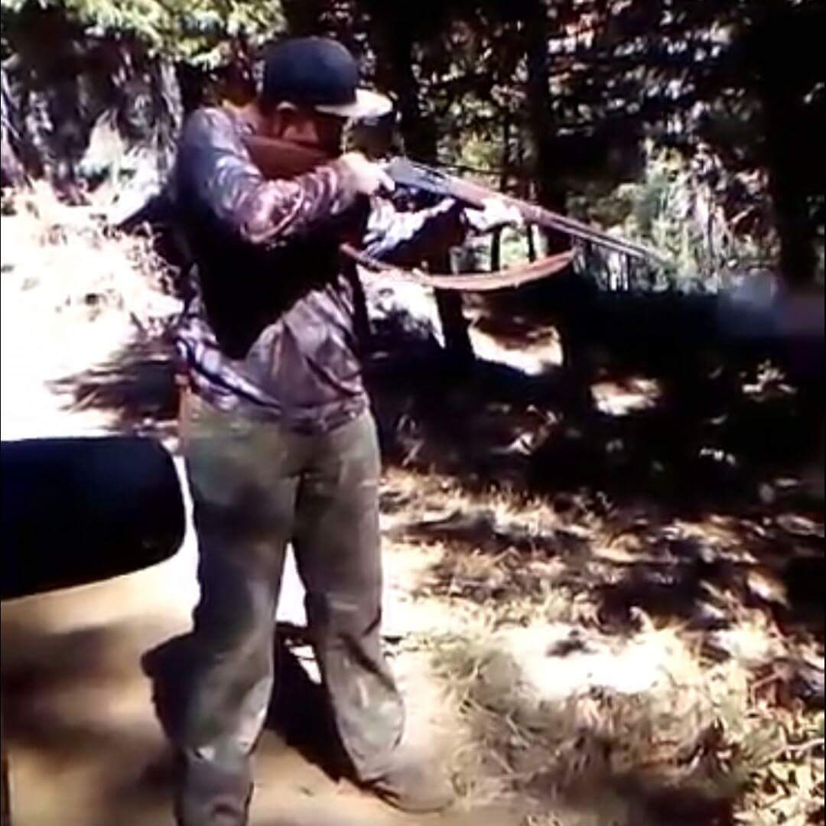
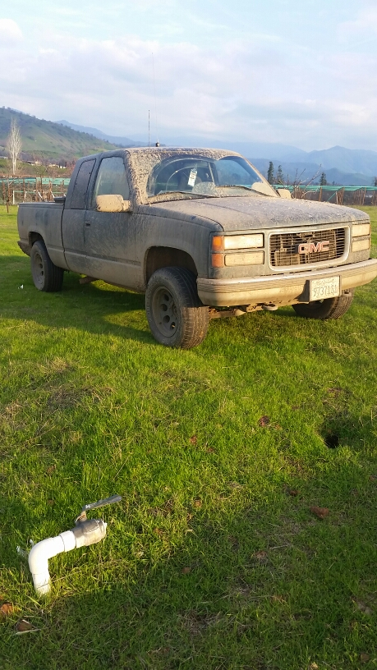
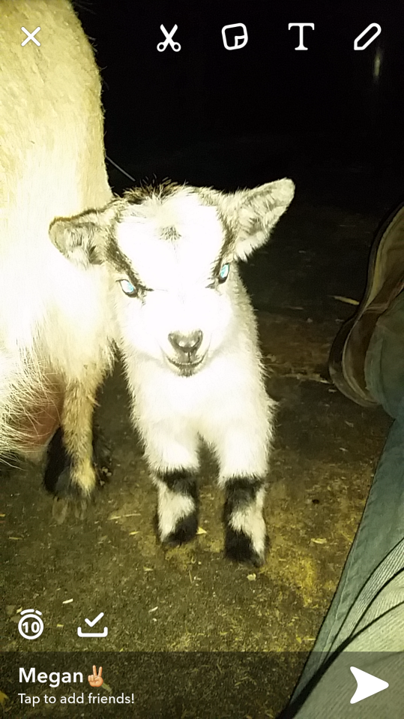
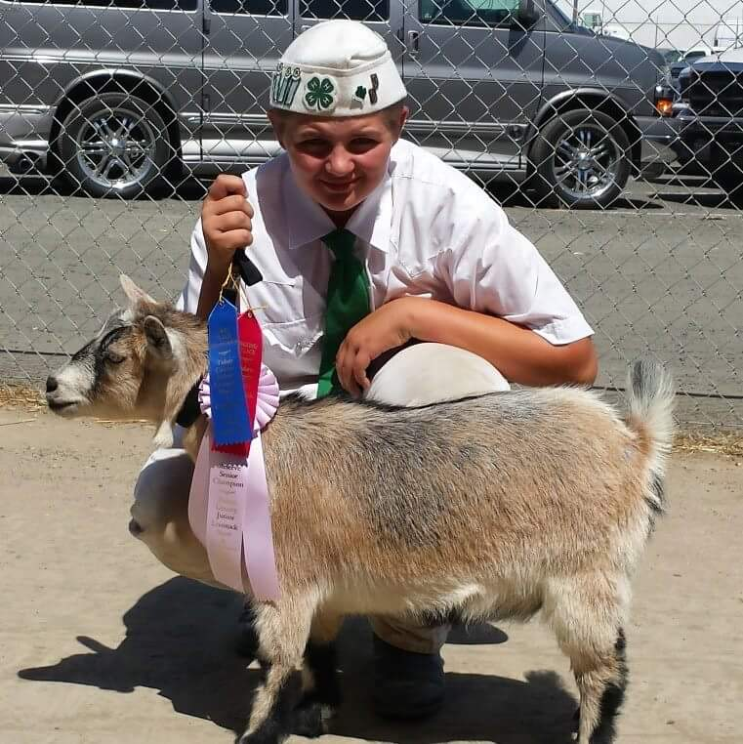
Any Questions

